Slide 1
Redux Sagas
Jason Monroe - 688776

Slide 2
Course Objective:
At the end this 90 min session, you will be able to
Implement Redux Saga Library in a React Redux Application

Slide 3
Benefits of Redux-Saga
Simplifies side-effect management
More efficient execution of data-fetching
Easier to test
Better at handling failures

Slide 4
Key Topics
Overview
Generator Functions
Watcher and Worker Sagas
Running Saga and applying as Middleware to Store
Implementation in React – coding practice
Expanding to multiple sagas – coding practice

Slide 5
Redux-Saga Overview

Slide 6

Integrates side-effects such as api calls into the Redux Layer
Side-effects abstracted into watcher and worker Sagas
Watcher Sagas watch for actions to be dispatched on store then kick off
A worker saga to handle the side-effect
Sagas run as separate threads with the use of Generator Functions
https://redux-saga.js.org/

Slide 7
Saga vs Thunk
Steeper learning curve
Threads can be started, paused,
cancelled and blocked
Utilizes Generator functions
No Callback hell
Test easily with equality
Easier for beginners
Logic is self-contained
Utilizes Callback functions
Callback hell!
Tough to test (needs mocks)
https://medium.com/@shoshanarosenfield/redux-thunk-vs-redux-saga-93fe82878b2d#:~:text=The%20idea%20is%20that%20a,application%20with%20normal%20Redux%20actions.

Slide 8
Generator Functions

Slide 9
Generator Functions*
Functions that can be exited and later re-entered
Defined with asterisk syntax: function* myGeneratorFunction(){}
yield keyword used within function body to return values
https://developer.mozilla.org/en-US/docs/Web/JavaScript/Reference/Statements/function*

Slide 10
Watcher and Worker Sagas

Slide 11
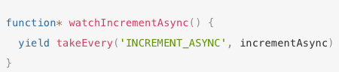
Watcher Saga
Listens for dispatched actions on Redux Store
Helper function calls worker saga which wraps side-effect
Worker saga
Helper function
Redux Action Type
https://redux-saga.js.org/docs/introduction/BeginnerTutorial.html

Slide 12
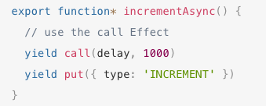
Worker Saga
Performs side-effect
Side-effect can be wrapped in call helper function to isolate it
Performs action on store with put if necessary
https://redux-saga.js.org/docs/introduction/BeginnerTutorial.html

Slide 13
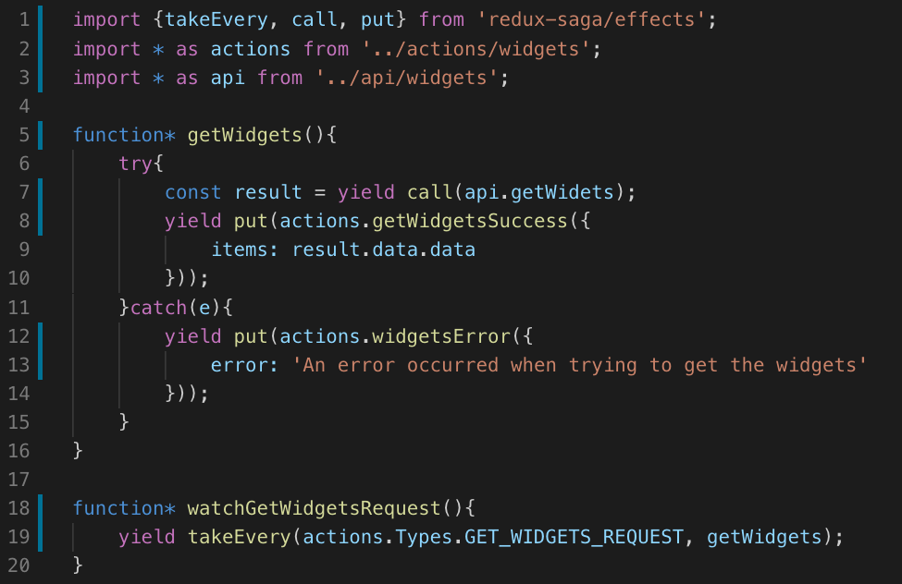
Redux-Saga Effect creators
take series
Instructs middleware to wait for a specified action on the store
Can call worker saga
put – dispatches action to store
call – calls function and waits for it to resolve
https://redux-saga.js.org/docs/api/

Slide 14
Running Sagas as Middleware

Slide 15
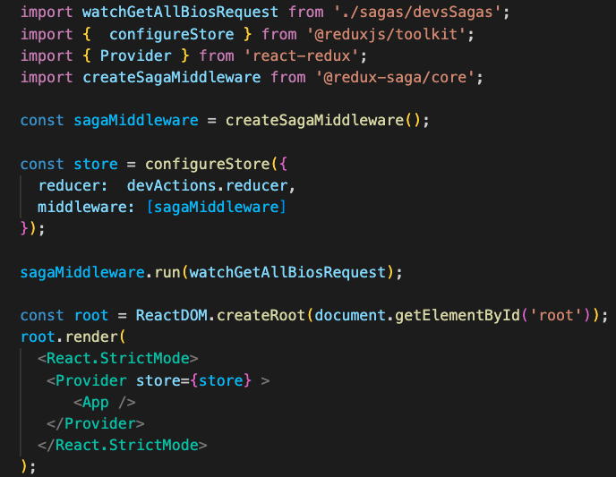
Running Saga as Middleware
Use applyMiddleware function from redux library
Pass createSagaMiddleware function from redux-saga library into array
Set array as value for middleware property in object passed to configureStore
Call run function from sagaMiddleware, passing it your root reducer
https://redux-saga.js.org/docs/introduction/BeginnerTutorial.html

Slide 16
Implementing in React

Slide 17

Code Along Practice – adding Redux-Saga
Install redux-saga
Abstract fetch call for getting developers to separate api folder and file.
Split getAllDeveloperBios action creator and GET_ALL_BIOS type into a Request and Success. Request is dummy and parameterless that watcher will watch for. Success will be executed by worker
Create watcher and worker saga for the Success mentioned above. Worker saga should use put() and a call action creator for Success
Delete componentDidMount and passing of dev prop to DisplayBios. Call getAllBiosRequestActionCreator from constructor.
Wire up saga in index.js
Fix render bug in DisplayBios with if/else.

Slide 18
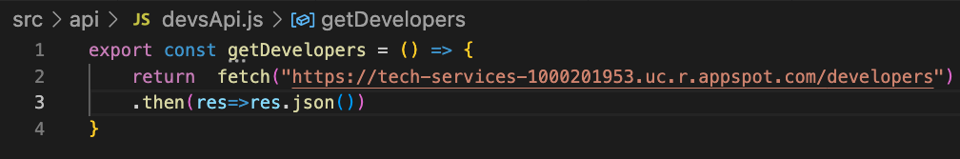
#2 API call

Slide 19
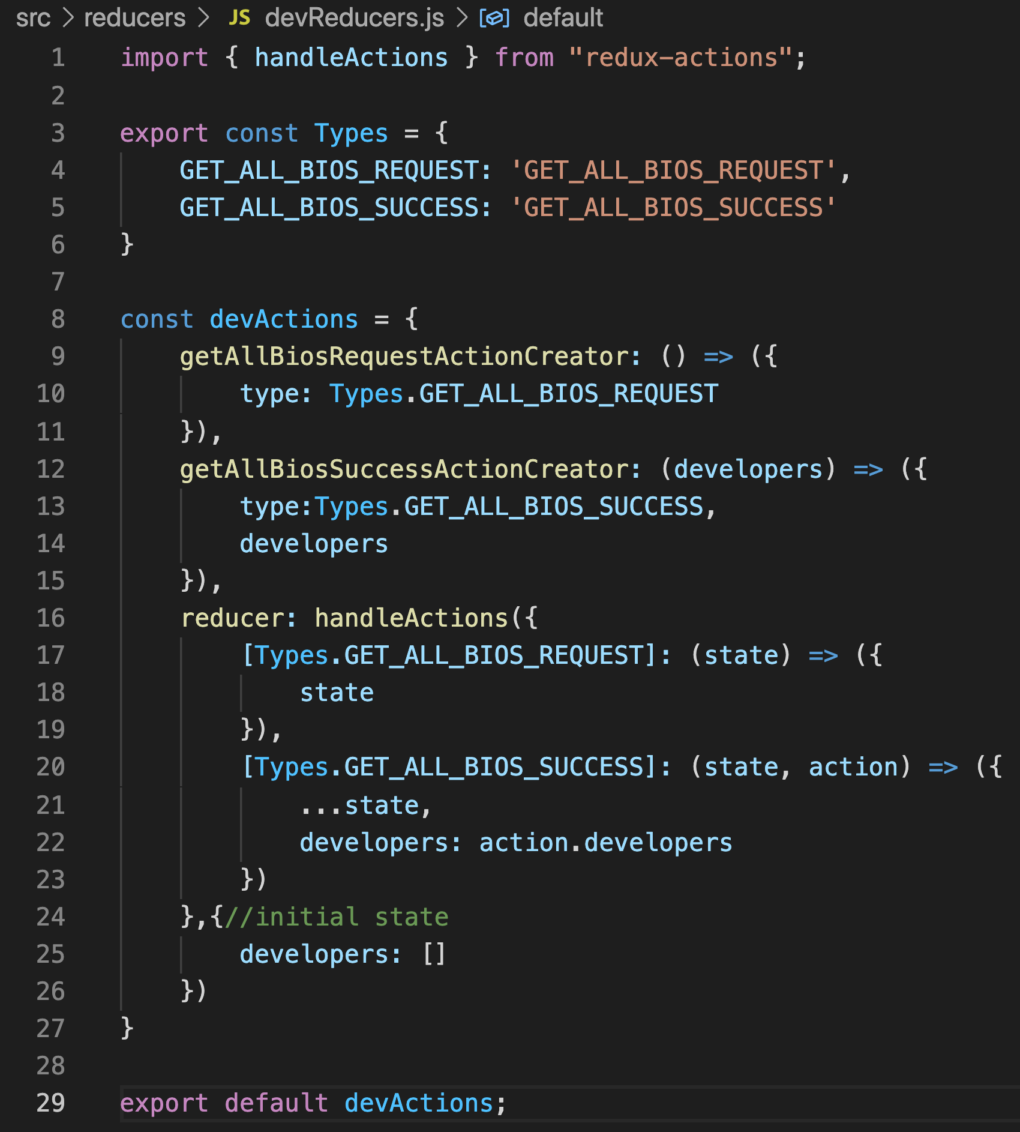
#3
Wrapped Types in Types object
Split GET_ALL_BIOS into REQUEST and SUCCESS
Renamed getAllBiosActionCreator to getAllBiosSuccessActionCreator
Created new getAllBiosRequestActionCreator that returns a type with no payload
Created reducer for GET_ALL_BIOS that just returns the state

Slide 20
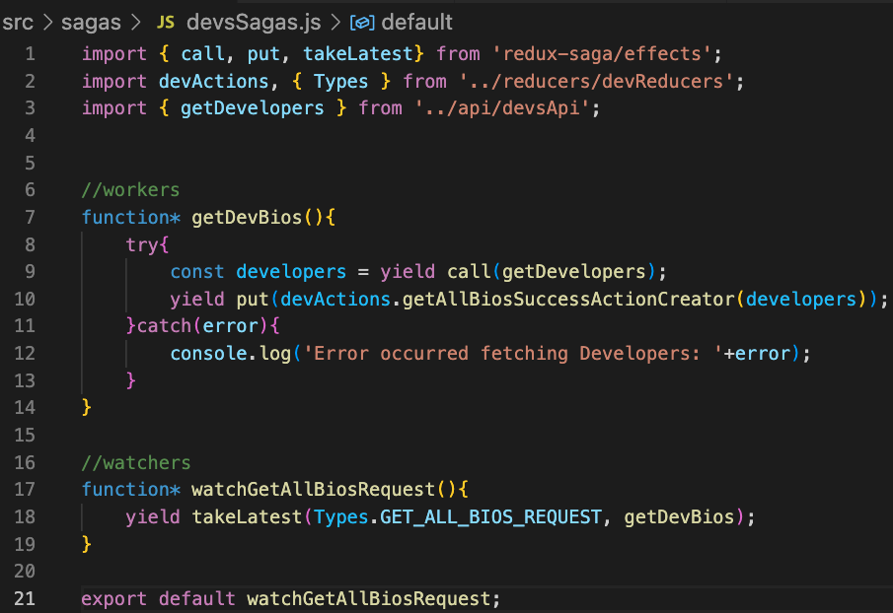
#4

Slide 21
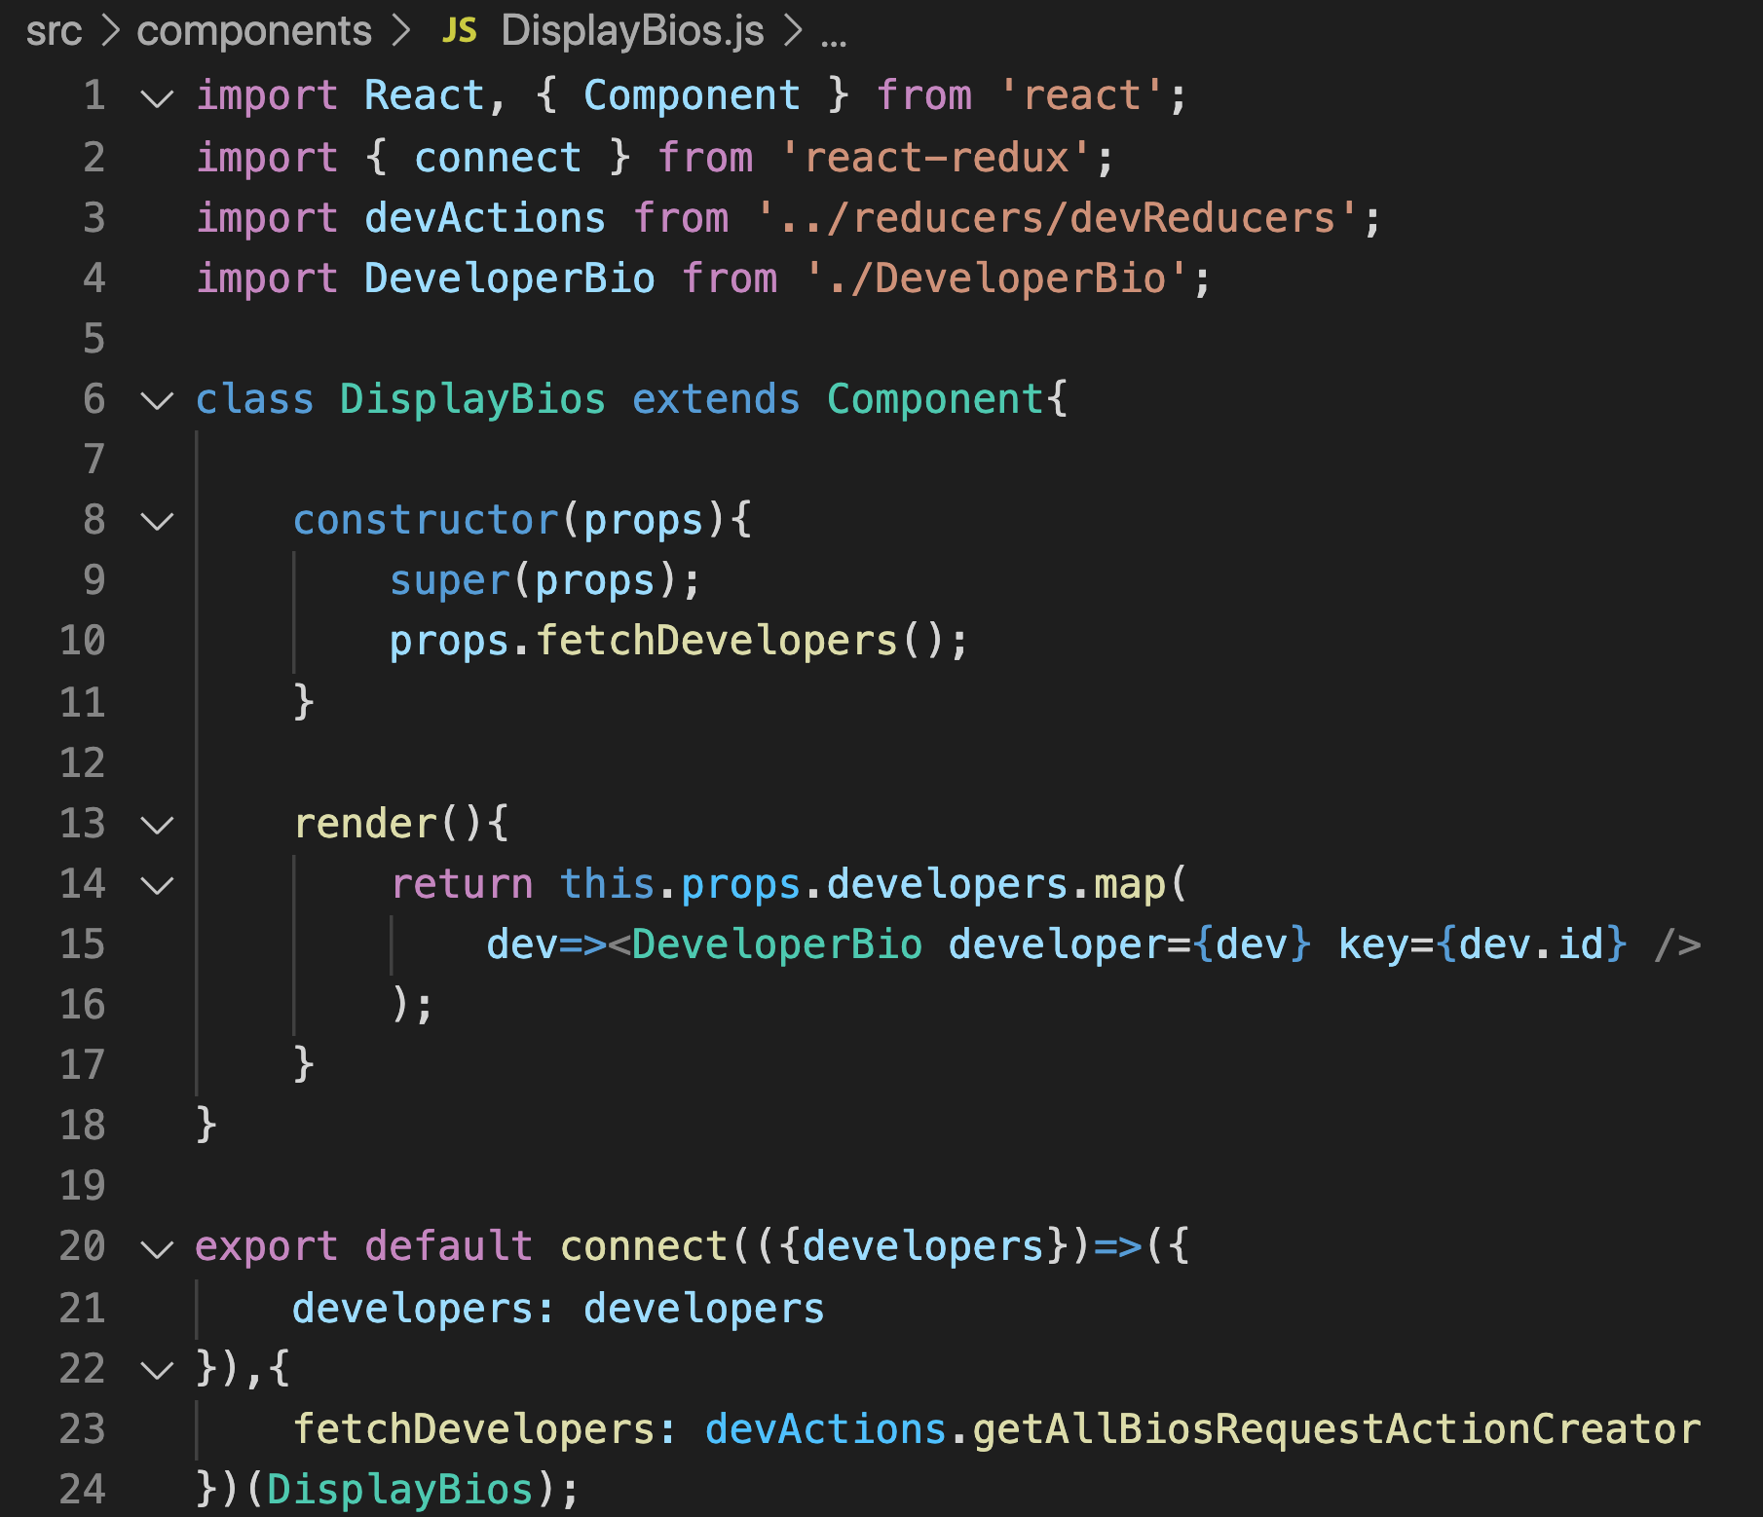
#5

Slide 22
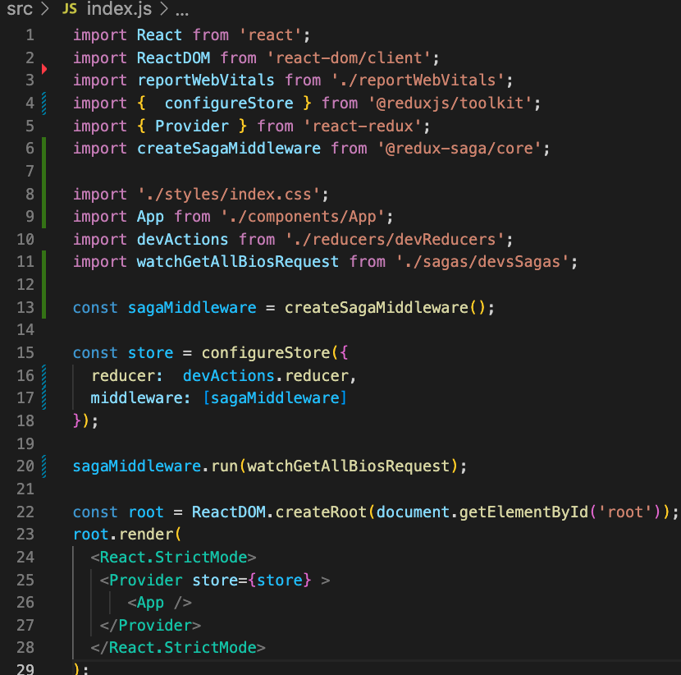
#6
Must be run before render, or else watcher may not be watching before getAllBiosRequestActionCreator is called from App

Slide 23
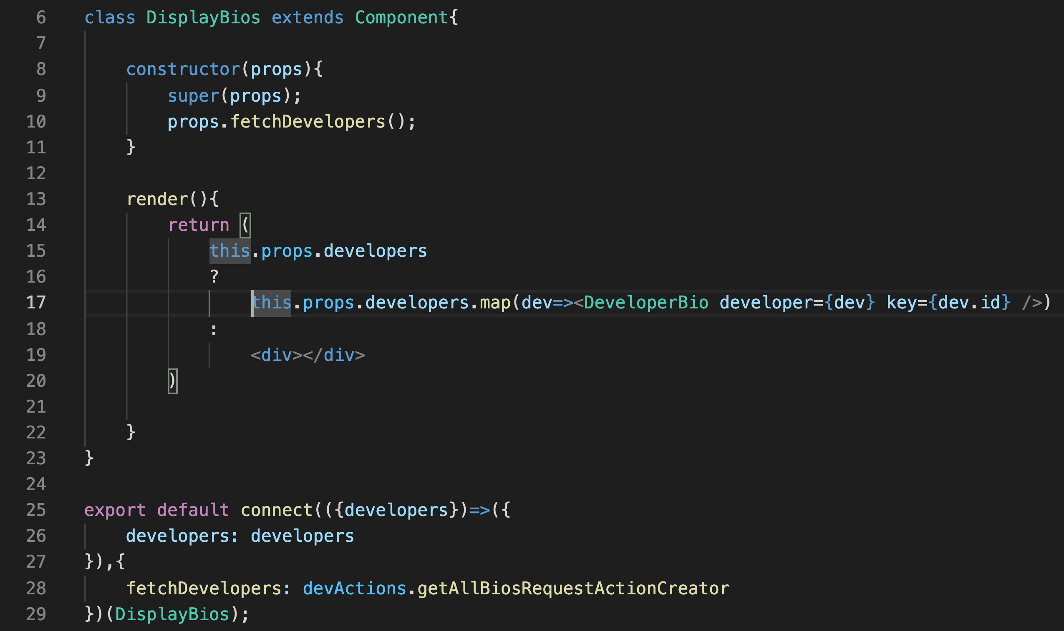
#7

Slide 24
Expand to Multiple Sagas

Slide 25
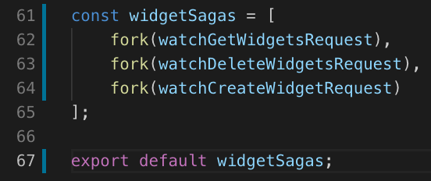
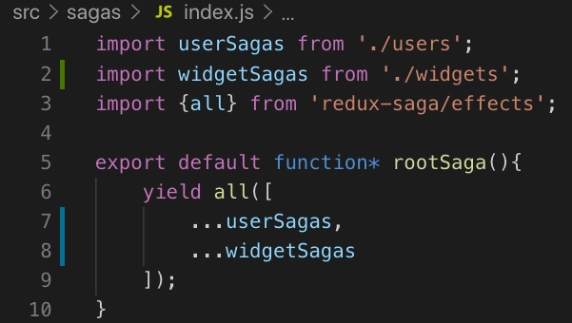
Expand to Multiple Sagas
Use fork() to run sagas in parallel
Export as array from individual saga files
Create index.js in saga folder and use yield all() to start these sagas inside of a rootSaga
Run rootSaga from main application index.js

Slide 26
Code Along Practice – adding additional Redux-Saga
Migrate fetch POST from AddDeveloper.js to api/developers.js
Create watcher and worker saga for addBio
Combine all watchers with fork in an array and export
Create index.js in saga folder with rootSaga
Wire up rootSaga in index.js

Slide 27
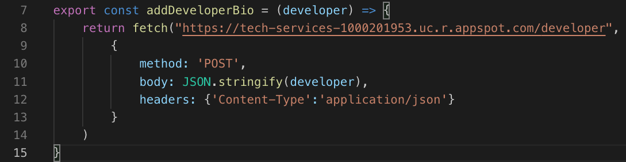
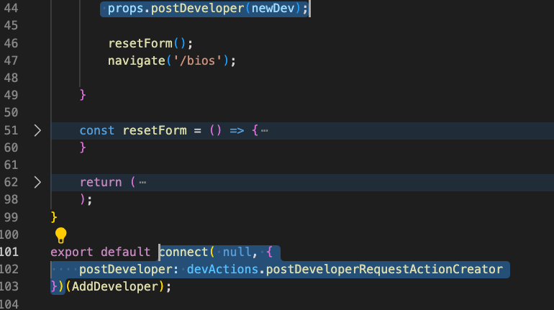
#1

Slide 28
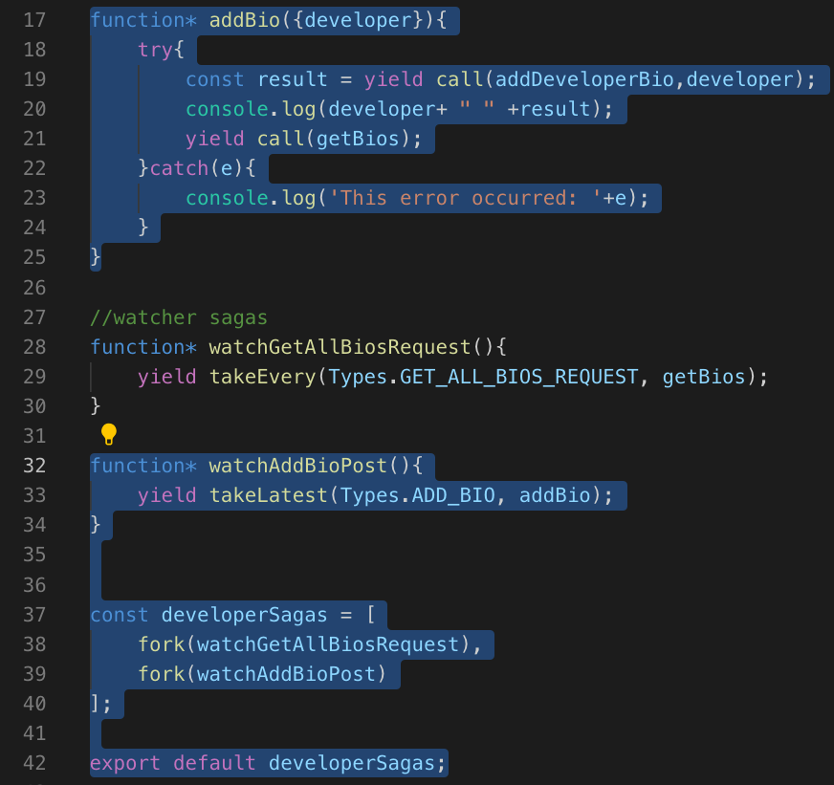
#2 and #3
Destructure developer from action object
Import from api/developers.js

Slide 29
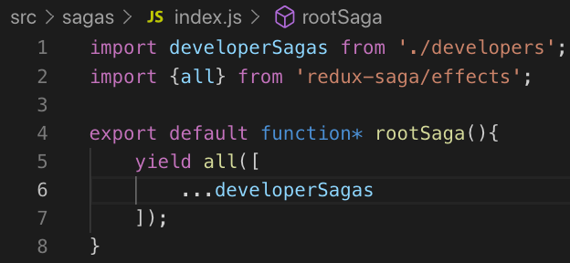
#4
Starts all sagas. Fork in individual saga files forks them

Slide 30
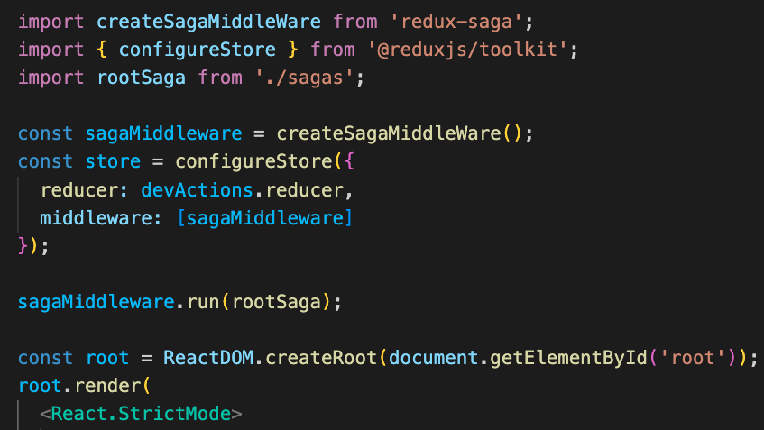
#5
Automatically imports from index.js inside sagas folder

Slide 31
Review

Slide 32
Review
Redux-Saga VS Thunk
Generator Functions*
Watchers
Workers
Effect functions
Multiple Sagas

Slide 33
Course Objective:
At the end this 150 min session, you will be able to
Implement Redux-Saga in a React application

Slide 34
Why wouldn’t Redux-Saga use await/async?
How difficult was it to convert to Redux-Saga?

Slide 35
Thank You

